Slide 1
CS6382 Algorithm Analysis and Game Theory
Game Theory Basics

Slide 2
Brief History of Game Theory
1913 - E. Zermelo provides the first theorem of game theory; asserts that chess is strictly determined
1928 - John von Neumann proves the minimax theorem
1944 - John von Neumann & Oskar Morgenstern write "Theory of Games and Economic Behavior”
1950-1953 - John Nash describes Nash equilibrium
Notes:
http://william-king.www.drexel.edu/top/class/histf.html

Slide 3
Rationality
Assumptions:
humans are rational beings
humans always seek the best alternative in a set of possible choices
Why assume rationality?
narrow down the range of possibilities
predictability
Notes:
Based on the assumption that human beings are absolutely rational in their economic choices. Specifically, the assumption is that each person maximizes her or his rewards -- profits, incomes, or subjective benefits -- in the circumstances that she or he faces. This hypothesis serves a double purpose in the study of the allocation of resources. First, it narrows the range of possibilities somewhat. Absolutely rational behavior is more predictable than irrational behavior. Second, it provides a criterion for evaluation of the efficiency of an economic system. If the system leads to a reduction in the rewards coming to some people, without producing more than compensating rewards to others (costs greater than benefits, broadly) then something is wrong. Pollution, the overexploitation of fisheries, and inadequate resources committed to research can all be examples of this.
Source:http://www.lebow.drexel.edu/economics/mccain/game/game.html

Slide 4
Utility Theory
Utility Theory based on:
rationality
maximization of utility
may not be a linear function of income or wealth
It is a quantification of a person's preferences with respect to certain objects.
Notes:
Few people would risk a sure gain of $1,000,000 for an even chance of gaining $10,000,000, for example. In fact, many decisions people make, such as buying insurance policies, playing lottery games, and gambling in a casino, indicate that they are not maximizing their average profits. Game theory does not attempt to indicate what a player's goal should be; instead, it shows the player how to attain his goal, whatever it may be.
Von Neumann and Morgenstern understood this distinction, and so to accommodate all players, whatever their goals, they constructed a theory of utility. They began by listing certain axioms that they felt all "rational" decision makers would follow (for example, if a person likes tea better than milk, and milk better than coffee, then that person should like tea better than coffee). They then proved that for such rational decision makers it was possible to define a utility function that would reflect an individual's preferences; basically, a utility function assigns to each of a player's
alternatives a number that conveys the relative attractiveness of that alternative.
Maximizing someone's utility automatically determines his most preferred option. In recent years, however, some doubt has been raised about whether people actually behave in accordance with these rational rules.
Source: http://search.britannica.com/bcom/eb/article/5/0,5716,117275+6,00.html
Values assigned to alternatives is based on the relative attractiveness to an individual.

Slide 5
What is Game Theory?
Game theory is a study of how to mathematically determine the best strategy for given conditions in order to optimize the outcome
Notes:
game theory focuses on how groups of people interact. Game theory focuses on how “players” in economic “games” behave when, to reach their goals, they have to predict how their opponents will react to their moves.
CONCLUSION:
As a conclusion Game theory is the study of competitive interaction; it analyzes possible outcomes in situations where people are trying to score points off each other, whether in bridge, politics of war. You do this by trying to anticipate the reaction of your competitor to your next move and then factoring that reaction into your actual decision. It teaches people to think several moves ahead. From now on , Whoever it was who said it doesn’t matter if you win or lose but how you play the game, missed the point. It matters very much. According to game theory, it’s how you play the game that usually determines whether you win or lose.
Source:http://www.ug.bcc.bilkent.edu.tr/~zyilmaz/proposal.html

Slide 6
Game Theory
Finding acceptable, if not optimal, strategies in conflict situations.
Abstraction of real complex situation
Game theory is highly mathematical
Game theory assumes all human interactions can be understood and navigated by presumptions.
Notes:
It is highly mathematical in order to emulated human value judgement (mental rules, fuzzy input of good or bad)
ex. Chess play

Slide 7
Why is game theory important?
All intelligent beings make decisions all the time.
AI needs to perform these tasks as a result.
Helps us to analyze situations more rationally and formulate an acceptable alternative with respect to circumstance.
Useful in modeling strategic decision-making
Games against opponents
Games against nature
Provides structured insight into the value of information
Notes:
WHY GAME THEORY IS IMPORTANT?
Game theory is both easy and excruciatingly difficult. People use it all the time, average people, in their daily lives. It comes into play in mundane deals like buying a car, where a certain skill in haggling is required. The buyer’s offer is usually formulated on the basis of what he or she presumes the seller will take. The seller is guided by a presumption about how high the buyer will go. The outcome of this negotiation could be totally positive (if the deal satisfies both parties), totally negative (if it falls through), or positive for one party and less so for the other (depending on how much is paid.)
It is used to describe any relationship and interaction, economic, social or political. And it’s useful in creating strategies for negotiators. It can help you win, and that is why companies and governments hire game theorists to write strategies against other players in whatever game they’re in. Mathematics and statistics are the tools they use. For example, during the Cold War the Pentagon became interested in game theory to help develop its nuclear strategy, and with some success.
You don’t make a move in chess without first trying to figure out how your opponent will react to it. Game theory assumes that all-human interactions, personal, institutional, economic, can be understood and navigated by presumptions similar to those of the chess player.
Source:http://www.ug.bcc.bilkent.edu.tr/~zyilmaz/proposal.html

Slide 8
Formulation of normal form games
Player set:
P={1,2,3,…,n} is the set of players.
Strategy set:
Si is the strategy vector for player i and Sij is the j-th strategy for player i.
Pure strategy:
Each player chooses exactly one strategy.
Definition:
Player i can choose from his strategy set. The set of profiles of strategies of all players is represented as the Cartesian product. ( use S to represent)
Player i has gain function gi: S->R that gives the player’s gain for a strategy Sij. R is a real number.

Slide 9
Dominant Strategy
A strategy Sij is said to be dominant ( or weakly dominant) if the following inequality holds:
gi (S1k1, S2k2,......., Sij,….., Snkn) ≥ gi (S1k1, S2k2,......., Sil,….., Snkn)
For all other agents’ profiles and j≠l.
If the inequality is strict, Sij is said to be strictly dominant strategy for player i.

Slide 10
Pareto dominance and Pareto optimality
Let s and t be two strategy profiles from S.
We say s weakly Pareto-dominates t if for i, 1≤i≤n. The following inequality holds:
gi(s)≥ gi(t)
If the inequality holds true for i, 1≤i≤n, and is strict for at least one j, 1≤j≤n, we say s Pareto-dominates t.
If inequality is strict for all i. We say t is strongly Pareto-dominated by s.
We say t is Pareto-optimal if for all s∈ S it holds that: If t is weakly Pareto-dominated by s, then
gi(s)= gi(t) for all i. That is, t is Pareto-optimal if there is no s∈ S that Pareto-dominates t.
We say t is weakly Pareto-optimal if there is no s∈ S that strongly Pareto-dominates t.

Slide 11
Nash Equilibrium in Pure Strategies
Equilibrium: A solution is stable if no player has an incentive to deviate from his/her strategy in this profile, provided that also all other players choose their strategies according to this profile.
1. A strategy Sij ∈ Si is said to be a best response strategy to the profile s-i ∈ S-i=S- Si of the other player’s strategies if for all strategies Sil ∈ Si the following inequality holds:
gi (S1k1, S2k2,......., Sij,….., Snkn) ≥ gi (S1k1, S2k2,......., Sil,….., Snkn)
2. If there is exactly one such strategy Sij ∈ Si of player i, then this is his/her strictly best response strategy to the other players’ strategy profile s-i.
3.A strategy profile s ∈ S is in a Nash equilibrium in pure strategies if for i, Sij ∈ Si is the best response strategy of player i.
4.If there is only one such strategy profile s, then s is in a strict Nash equilibrium in pure strategies.

Slide 12
Relations
Weakly Pareto-optimal strategies
Nash equilibrium in pure strategies
strict Nash equilibrium in pure strategies
dominant strategies
Pareto-optimal strategies
Strictly dominant strategies

Slide 13
Algorithmic Game Theory
Inefficiency of Equilibrium (This lecture)
Complexity of Finding Equilibrium (This lecture)
Market Equilibrium (Matching, Auction)
Multiagent Systems (Fair Division, Scheduling)
Algorithmic Mechanism Design (Facility Location Games)
Computational Social Choice (A broader field)

Slide 14
POS and POA (Inefficiency of Equilibria)
Price of Anarchy:
Characterize how bad a Nash Equilibrium can be
Price of Stability:
Characterize how good a Nash Equilibrium can be

Slide 15
Hardness of computing Nash Equilibrium
Zero-Sum Games: Polynomial time
Since each player tries to minimize the maximum gain of the other player and maximize his/her own gain correspondingly by Zero-Sum property. The computational process of Nash Equilibrium can be transformed to a minimax strategy problem which can be expressed as a linear program. Such program can be computed in polynomial time.
General Normal Form Game: PPAD-Complete
PPAD(Polynomial Parity Argument for Directed Graphs)- end of the line
G is a (possibly exponentially large) directed graph with no isolated vertices, and with every vertex having at most one predecessor and one successor. G is specified by giving a polynomial-time computable function f(v) (polynomial in the size of v) that returns the predecessor and successor (if they exist) of the vertex v. Given a vertex s in G with no predecessor, find a vertex t≠s with no predecessor or no successor. (The input to the problem is the source vertex s and the function f(v)). In other words, we want any source or sink of the directed graph other than s.

Slide 16
Hardness of computing Nash Equilibrium
Sperner Lemma is used to do the reduction

Slide 17
Types of Games
Sequential vs. Simultaneous moves
Zero vs. non-zero sum
Single Play vs. Iterated
Perfect vs. Imperfect information
Cooperative vs. Noncoopretive

Slide 18
Sequential vs. Simultaneous
Sequential (Extensive form game, combinatorial game theory)
Players play alternatively
Chess
Go
Nim Game
Simultaneous (Normal form game)
Payoff matrix
Game dynamics
One by one
At the same time

Slide 19
Payoff Matrix Notation
Notes: Player I's strategy A may be different from Player II's.
P2 can be omitted if zero-sum game

Slide 20
Prisoner’s Dilemma
NCE
Prisoner 2
Blame
Don't
Blame
10 , 10
0 , 20
Prisoner 1
Don't
20 , 0
1 , 1
Notes: Higher payoffs (longer sentences) are bad.
Non-cooperative equilibrium ≠ Joint maximum
Jt. max.

Slide 21
Chicken’s Game (Non-zero Sum)
Hawk/Dove Game
P1\P2 | Fight | Dodge
Fight | (-1000, -1000) | (+1, -1)
Dodge | (-1, +1) | (0,0)

Slide 22
Rock/Scissor/Paper (Zero-Sum)
P1\P2 | Rock | Scissor | Paper
Rock | (0,0) | (+1,-1) | (-1,+1)
Scissor | (-1,+1) | (0,0) | (+1,-1)
Paper | (+1,-1) | (-1,+1) | (0,0)

Slide 23
Soccer’s Game (Zero Sum or?)
Shooter\Goal Keeper | Left | Middle | Right
Left | (0,1) | (1,0) | (1,0)
Middle | (1,0) | (0,1) | (1,0)
Right | (1,0) | (1,0) | (0,1)

Slide 24
Nash equilibrium in mixed strategy
Existence of Nash Equilibria in Mixed Strategies
Mixed strategy
Mixed strategies are convex combinations of pure strategies on the vertices of the simplex
Best response
Fixing other agents’ strategies, what is the best for agent i?
Nash’s Theorem:
For each noncooperative game in normal form with a finite number of players each having a finite set of strategies, there exists a Nash equilibrium in mixed strategies.

Slide 25
Single play vs. Iterated
Single play
Play once
Iterated
Finite repeats of games
Infinite repeats of games
What happens for Prisoner’s Dilemma?
Retaliation
Negotiation
…

Slide 26
Games with Incomplete Information
Also called Bayesian game
The monty hall problem ( conditional probability and Bayesian Nash equilibrium)
No matter which door is revealed, the best strategy is always to change the door you choose.
Bayesian Nash equilibrium:
In a Bayesian game, a Bayesian Nash equilibrium for risk-neutral player is defined to be a strategy profile that maximizes the expected gains of all players depending on what each player believes about the strategies chosen by the other players

Slide 27
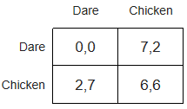
Games with Incomplete Information
Also called Bayesian game
In new product game:
Company A may not know the demand of its new product and whether company B will sell products of the same type.
Chicken game (Bayesian version):
Originally in pure strategy version or mixed strategy version, competitors are always set to be risk-neutral and gain functions are not changed. Here we introduce new type of gain functions which are changed based on the type of competitors
One example for original version

Slide 28
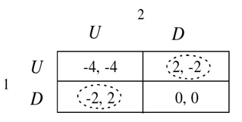
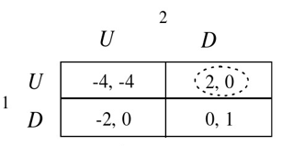
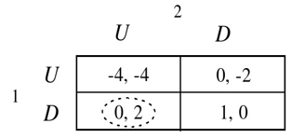
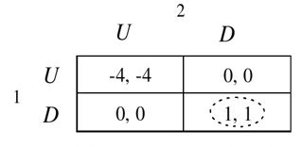
Games with Incomplete Information
Also called Bayesian game
Both aggressive
P1 aggressive and P2 feeble
P1 feeble and p2 aggressive
Both feeble

Slide 29
Games with Incomplete Information
Also called Bayesian game
Harsanyi transformation:
Introduce the 3rd player “nature” and let it compete with the original player. This player will not have any gaining function and only take the role of selecting the type for each player individually. P1 will know the selection result for himself and get a distribution of probability for P2’s possible types. Same for P2.
The distribution function is common knowledge.
Then the two original players will continue the chicken game and the gaining function for each player’s expected gain will be his gaining function.
We consider an aggressive player1 and p₁ is the probability of having an aggressive player2. x is the probability for aggressive player2 to choose U.
u₁(U)=p₁(-4x+2*(1-x))+2*(1-p₁) u₁(D)=p₁(-2x+0*(1-x))+0*(1-p₁)

Slide 30
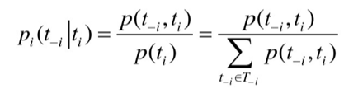
Games with Incomplete Information
Also called Bayesian game
Notification:
Let t=( t₁,….t_{n}） be one of the type combination of all players
t_{-i} be one of the type combination of all players except player i
T_{i} be the type set of player
1. Nature will only take the role of selecting type for each player i. And only i knows the exact type of himself.
2. There will be a distribution function p(t₁,….t_{n}) for nature when selecting the type combination for players. And such function is common knowledge.
So, player i can use Bayesian probability to calculate the probability distribution for other players.

Slide 31
Games with Incomplete Information
Also called Bayesian game
Given the common knowledge function
p(aa)=0.2 p(af)=0.3 p(fa)=0.2 p(ff)=0.3
Aggressive player 1 will have :P2(a|a)=0.4 P2(f|a)=0.6
Feeble player 1 will have : P2(a|f)=0.4 P2(f|f)=0.6
Aggressive player 2 will have :P1(a|a)=0.5 P1(f|a)=0.5
Feeble player 2 will have: P1(a|f)=0.5 P1(f|f)=0.5

Slide 32

Games with Incomplete Information
Also called Bayesian game
Equilibrium in Bayesian game:
Player i will also select the action a_{i}*(t_{i}) which will maximize his expected gain when the decision set of other players s_{-i} are given.
A decision set (a₁*(t₁) , a₂*(t₂) ,…, a_{n}*(t_{n}) ) is a Bayesian Nash Equilibrium if for each player I the following equality holds

Slide 33
Cooperative vs. Non-cooperative
All previous examples are non-cooperative games
Cooperative game
Gloves game
Player 1 and 2 each holds a left glove, player 3 holds a right glove
Pair of gloves is worth 1
Value gained by coalitions
{1,3}, {2,3}, {1,2,3} →value 1
Others 0
Shapley value
How to distribute value 1 to three players
S(1)=S(2)=1/6, S(3)=2/3

Slide 34
How to calculate Shapley value
X1+X2+X3=1
Consider all 6 arriving orders
What is the marginal value brought by player 1?
Only the sequence 3,1,2 makes player 1 valuable
S(1)=1/6
By symmetry S(2)=1/6
By sum=1, S(3)=2/3

Slide 35
Stackelberg Game (Leader-Follower Game)
Leader announces some value (could be budget)
Followers play the game with the value specified by the leader
For different values, the game will achieve different equilibrium
How should the leader select the value?

Slide 36
Stackelberg Game (Leader-Follower Game)
Consider a normal-form game
Now suppose the game is played as follows:​
Player 1 [Leader] commits to playing one of the rows,​
Player 2 [Follower] observes the commitment and then chooses a column​
Stackelberg Equilibrium: What is the optimal strategy for player 1?
2, 1​ | 4, 0​
1, 0​ | 3, 1​

Slide 37
Application Examples and paradoxes

Slide 38
Shortest Path Auctions
A buyer wants to purchase a path from s to t in a graph
Selfish agents own the edges
Edge costs are private
Only the selfish agents know the true costs
We want to lower the buyer’s expected payments in shortest path auctions

Slide 39
One possible solution
All edges submit their bids
The buyer chooses the cheapest path
The buyer pays each winning agent its threshold bid
The highest amount that agent can bid and remain on the chosen path
Truthful
May have extremely high costs
Bad behavior when we have long vertex-disjoint paths

Slide 40
Reducing Payments
Can we modify the graph?
Adding new edges is not possible
These are resources we do not have
Removing edges can be performed by prohibiting some agents from participating
Counter-intuitive: we are reducing the competition. Why would this reduce the payments?

Slide 41
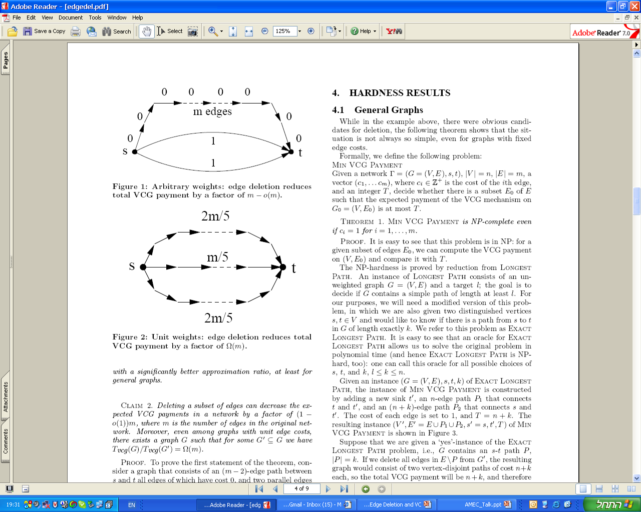
Deleting can be rewarding
The m edges path wins. The threshold bid of each edge is 1.
We pay a total of m.
If we remove any edge on the long path, one of the lower edges wins. Its threshold bid is 1, so it is paid 1.
Edge deletion can give a performance ratio of m.

Slide 42
Classifications
Nash Equilibrium does not exist
Nash Equilibrium exists but not every path converges to a Nash Equilibrium
cycle exists
Nash Equilibrium exists and every path converges to a Nash Equilibrium
potential function exists

Slide 43
Example: Total Distance Game
m players play on a graph with n vertices
each chooses one vertex
Try to maximize his total distance to all the other players
Which category?

Slide 44
How Bad is Selfish Routing?
Latency function: l(x) where x is the traffic
v
v
l(x)=x
l(x)=1
l(x)=x
l(x)=1
s
t
s
l(x)=0
t
l(x)=1
l(x)=x
l(x)=1
l(x)=x
w
w
Adding an edge makes the latency larger: counter-intuitive

Slide 45
Isolation Games
Shop allocation
To have more customers
To keep away from other shops
Product design
Different from other products
Approximation of Voronoi game
Maximize the area of voronoi cell
Maximize the distance from all the other players.

Slide 46









Isolation game
Game space
Configuration
Distance vector
Weight vector
Utility function

Slide 47


Farness measurement
Single selection
Monotonically increasing
Monotonically decreasing
All distance

Slide 48


Game spaces
asymmetric
continuous
1-D circular
symmetric
general
discrete
hypercube
1D-circular
Examples:
nearest neighbor isolation game
total distance isolation game

Slide 49
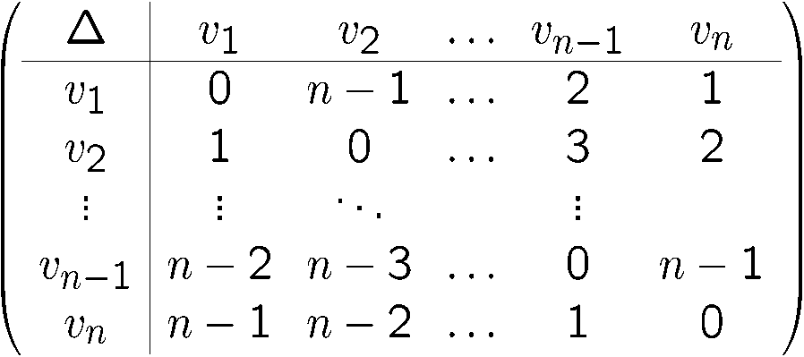

Asymmetric spaces
May have no Nash equilibrium
Theorem: No Nash equilibrium if
Length=2
Theorem: NP hard to decide whether there is a Nash equilibrium.
Length=3

Slide 50

Symmetric spaces
Finite spaces
Both are potential games.
Both have Nash equilibriums.
Hyper-cubes
NP hard to decide whether some configuration is a Nash equilibrium
const
const
Polynomial time

Slide 51

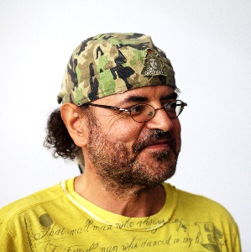
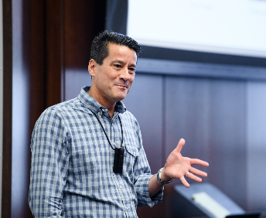
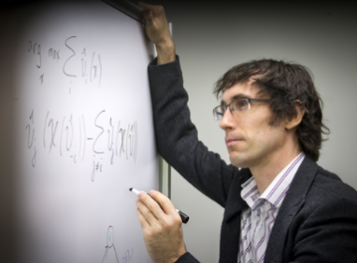
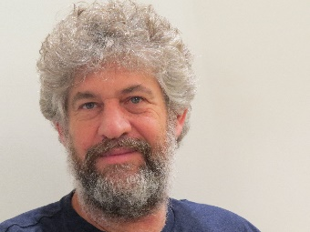
Computational Game Theory = CS + Game Theory
While the area of game theory originates from the economic literature, computer scientists have made significant contributions to this area from the modeling and computational perspectives in the last decades
The new area is known as computational game theory or algorithmic game theory
Representations of Games
Computing and Evaluating Equilibrium Concepts
Applications of Game Theory

Slide 52
Computational Questions
So, what is next since many of the computational questions are hard?
Study games with special structures
Look at brute force algorithms to find equilibria
Look at efficient algorithms and heuristics to compute approximate equilibria
Study alternative solution concepts

Slide 53
Learning in Games
Approach we have taken so far when playing a game: just compute an optimal/equilibrium strategy
Another approach: learn how to play a game by
playing it many times, and
updating your strategy based on experience
Why?
Some of the game’s utilities (especially the other players’) may be unknown to you
The other players may not be playing an equilibrium strategy
Computing an optimal strategy can be hard
Learning is what humans typically do
....
Learning strategies - strategies for the repeated game
Fictitious play, no-regret Learning algorithms, targeted learning
Does learning converge to equilibrium?

Slide 54
Computational Questions
Given a game (along with its representations) and an equilibrium concept (i.e., Nash equilibrium):
(Existence) Does the equilibrium exist? If so, find one or all.
(Guaranteed Properties) Does there exist an equilibrium in which, e.g.,
(Social welfare) the social welfare is at least k?
(Payoff) player i obtains an expected payoff of at least v?
(Uniqueness) a unique equilibrium in G?

Slide 55
Game Theory Modeling and Application Research
Step 1: Think about your problem domain (e.g., identify players, actions, and utility functions); the utility functions should be parameterized with parameters and depend on agents’ actions
Step 2: Identify an equilibrium concept and look at the computational and/or evaluation questions (hardness results and/or algorithms)
Step 3: Conduct simulations to highlight equilibrium behaviors using real-world parameters or instances

Slide 56
Variants of Security Games Used and Deployed in Real World
[Teamcore]
Notes:
Finally, some subsets of our model have been used in real-life
By the LAX airport, US coast guard
Let me show you this video that the Coast guard admiral talked
About game theory in congressional hearing
Joke (maybe)
Mention about differences of RGGs

Slide 57


Domain Specific Game-theoretic Models
Interdependent Security Games
Influence Games
Influence Maximization Games
Public Good Contribution Games
Schelling Games
Voting Games
Many more ... and in other CS areas
Schelling Games of
Residential Segregation
Influence Games on Networks
Main Contributions: (1) Introducing game-theoretic models for their domains, (2) analyzing and computing (Nash) equilibria, and (3 optional) experimental evaluations of the algorithms
Notes:
Finally, some subsets of our model have been used in real-life
By the LAX airport, US coast guard
Let me show you this video that the Coast guard admiral talked
About game theory in congressional hearing
Joke (maybe)
Mention about differences of RGGs

Slide 58
Source
A few slides borrowed from:
courses.ischool.berkeley.edu/i231/s07/gt_2007.ppt
A tutorial by Hau Chan

